Slide 1
Hello.

Slide 2
ATIRA is India’s leading composite research institute and largest textile research institute running autonomously as a non-profit org.
We are 68 years young.

Slide 3
and of course… to enhance knowledge in composites through research, development and training.

Slide 4
Our services
Testing & Certification
Pre-form Development
Composites Processing
Skill Development
Industrial Projects

Slide 5
Our collaborators
Karlsruhe Institute of Technology (KIT)
Germany
Fraunhoffer ICT, Germany
North-West Composite Centre, University of Manchester, UK
ITA, Aachen , Germany
Faserinstitute, University of Bremen, Germany

Slide 6
Global clients
OWENS CORNING CHAMBERY INTERNATIONAL, France
SPIG S.P.A , Italy
Corroserv (M) Sdn Bhd , Malaysia
Unique Fiberglass & Composites LLC, U.A.E
HAMON COOLING TOWER COMPANY, U.A.E

Slide 7
LAB AND TESTING FACILITIES

Slide 8
Mechanical Lab
In collaboration with
NWCC, UK
And
INSTRON, USA

Slide 9
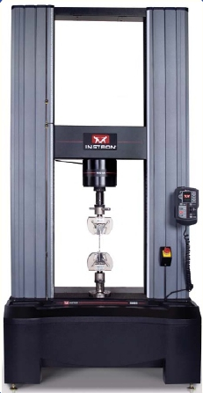
1. Dual column floor mounted UTM
100 KN & 400 KN
Tensile, Compression, Flexural, ILSS, IPSS, Poisson ratio, Shear Modulus, Fracture toughness etc.

Slide 10
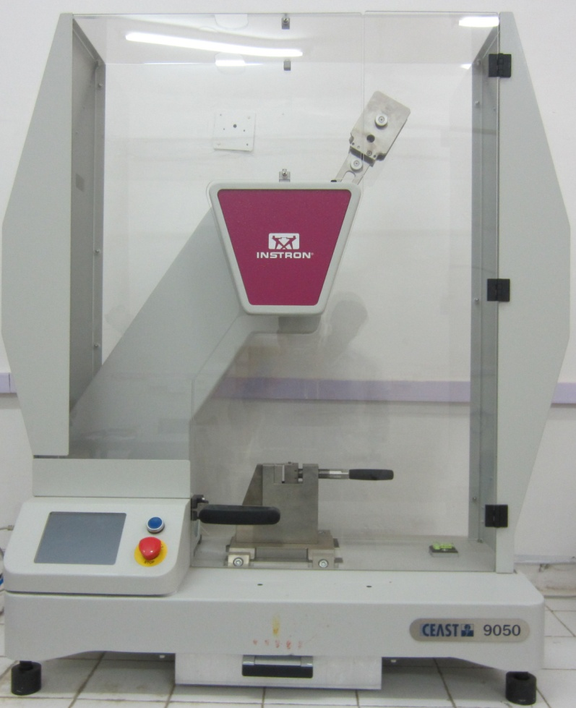
2. Motorized Pendulum Impact Tester
Izod and Charpy tests.
Range : 0.5 J - 25 J

Slide 11
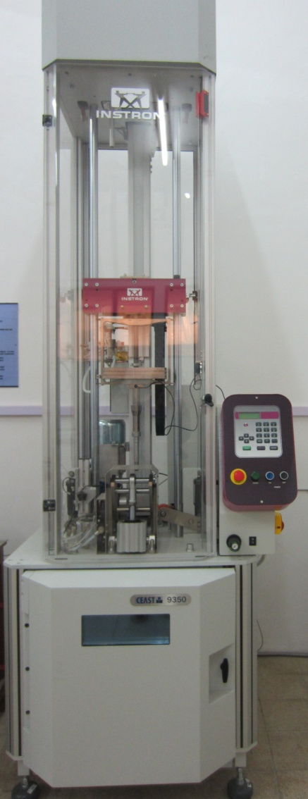
3. Drop Weight Impact Tester
High energy falling weight Impact Machine for testing various Composite Materials.
Max. Vel. 24 m/s with mass 2 kg
Min. vel. 7 m/s with mass70 kg

Slide 12
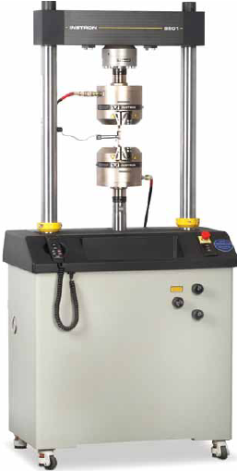
4. SERVOHYDRAULIC Tension Torsion 100KN / 1KNm
Dynamic and static testing on a variety of materials and components and for study of Fracture Mechanism

Slide 13
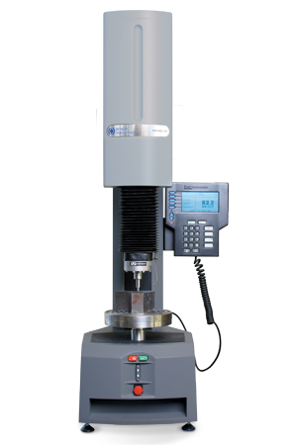
5. Wilson Hardness Tester
Rockwell Hardness
Hardness scale :
Regular and
Superficial

Slide 14
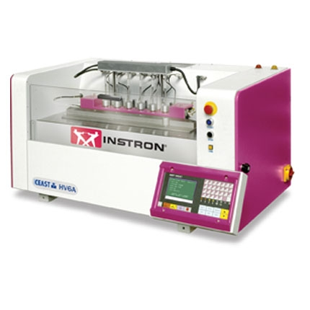
6. HDT / VSP Tester
Heat Deflection Temperature and Vicat Softening Point for polymer up to
300 ˚C

Slide 15
7. Notch Cutting Machine
with Motorized Linear Movement of Cutting
Sample preparation for
Pendulum Impact test.

Slide 16
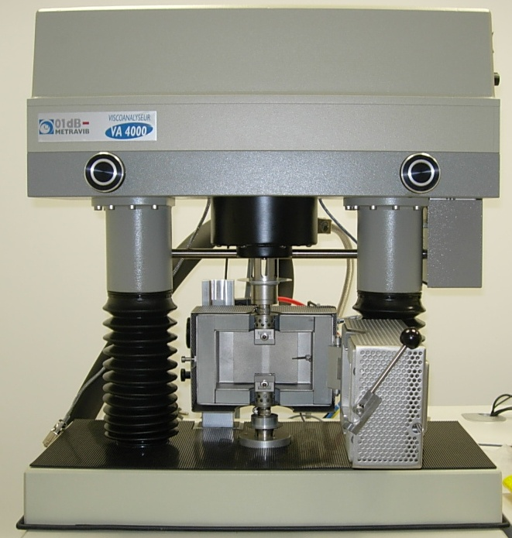
8. Dynamic Mechanical Analyzer- MetraviB (DMA) 150N
Young Modulus E*, E’, E”; Shear Modulus G*, G’, G’’; Loss factor tan δ, Loss angle δ: Dynamic Viscosity; Mechanical properties’ dependence to excitation frequency, time and temperature

Slide 17
Heat and Flame Lab

Slide 18
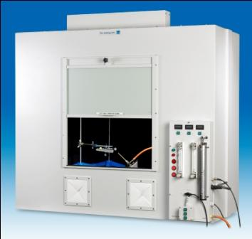
1. Flame Chamber
Conforms to all UL 94 Horizontal
and Vertical Bunsen burner tests
and associated
International Standards

Slide 19
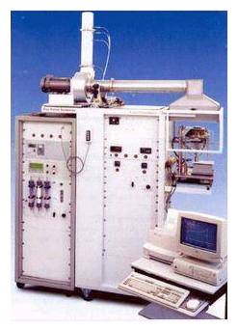
2. Cone Calorimeter
Measures Rate of heat release, smoke release rates, time to ignition, Mass loss rates, effective heat of combustion,
rate of release of toxic gas

Slide 20
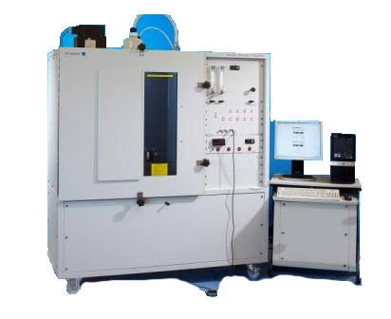
3.NBS Smoke Density Chamber
Determination of smoke
generated by
solid materials & assemblies

Slide 21
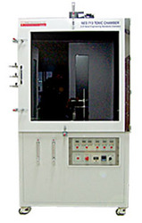
4. Toxicity Index
Toxicity of products of combustion in terms of small molecular species & to compare combustion characteristics of natural & synthetic materials

Slide 22
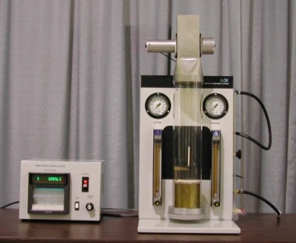
5. Limiting Oxygen Index
Determination of
Min% of O2 required
to marginally support combustion

Slide 23
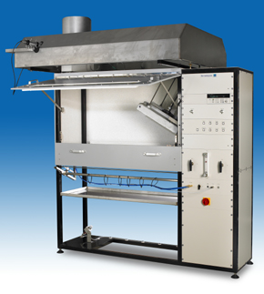
6. Flooring Radiant Panel
Determination of
horizontal surface spread
of flame for floor coverings

Slide 24
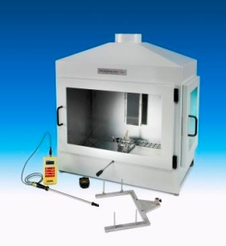
7. Single-Flame Source Test
Determination of susceptibility to fire of
wall & roofing products

Slide 25
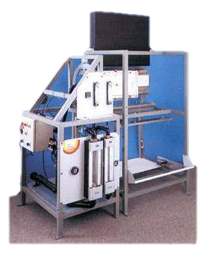
8. ISO 5658/Imo/ Lift Spread Of Flame Apparatus
Performance of flat materials
used as wall surfaces

Slide 26
Electrical Testing

Slide 27
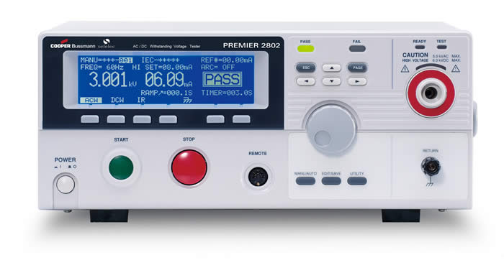
1. Dielectric strength

Slide 28
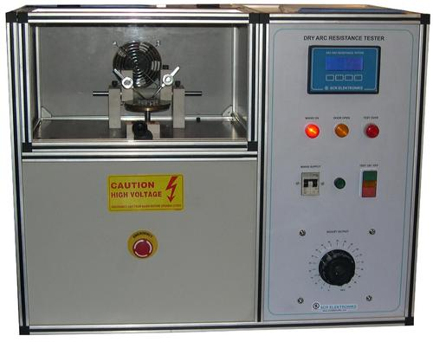
2. Dry arc resistance tester

Slide 29
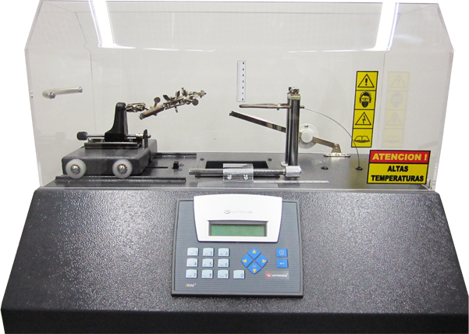
3. Glow wire test

Slide 30
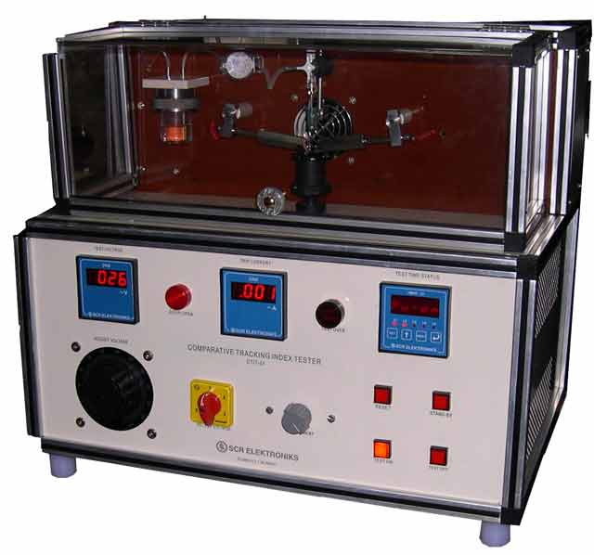
4. Comparitive tracking index

Slide 31
General info.
MoU with ISRO to develop payload components using FRP

Slide 32
Incubation Center for Braiding and Prepegs

Slide 33
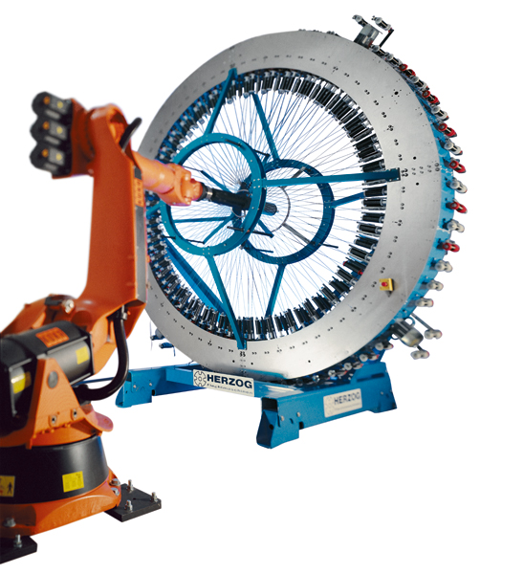
2 1/2 Radial Braiding Machine

Slide 34
One of the largest braiding machine in India with capacity to braid 1.0 m dia. And 1.5 length.

Slide 35
Vacuum Infusion Lab

Slide 36
State of the art facility to develop prototypes by using vacuum infusion & vacuum bagging process.

Slide 37
Developed various CFRP, GFRP, KFRP, JFRP, BFRP, components for varous organizations like ISRO, PRL, IPR, Industries and institutes.

Slide 38
Dornier 190 weaving machine

Slide 39
Composite products developed in vacuum infusion
Aerospace components.
Rear spring of automobiles.
Resin sheet manufacturing for coupon testing .
Sandwich panel preparation for coupon testing.
Coupon preparation for raw material qualification from the materials Glass fabric, carbon fabric, aramid fabric and jute fabric.

Slide 40
Pultrusion Lab

Slide 41
Machines and processes
Martin Pultrusion, USA
(Technology Partner)

Slide 42
DurapolR 2410 left-handed pultrusion

Slide 43
Durapol 7824
Programmable and Automated fiber glass slitter with
explosion proof refrigerated system

Slide 44
Circum Winding Equipment

Slide 45
MVP PU Injection System

Slide 46
Pul –vision Thermal analyzer and accessories for resin analysis

Slide 47
Skill Development Programs

Slide 48
Composites Training
Skill Development Courses
Certificate course on composites manufacturing with emphasis on Pultrusion
Duration: 02 months
Prerequisite: ITI/ Diploma/BE (Plastics/mechanical/Chemical)

Slide 49
Prototype development
Developed FRP component for satellites in GSAT 19, GSAT 11, GSAT 6A, GSAT 29.
And many more.
Developed Anechoic chamber by using Pultrusion profile.

Slide 50
Prototype development
Developed FRP component from natural fibers like
Jute composite (used for toilet) , cotton composite (electrical application).

Slide 51
Achievement
Received Innovative product award by ICERP 2017
Award for Special recognition
By Smt. Smriti Zubin Irani
Minister of textiles

Slide 53
Standards for the FRP composites
Standard is a laid out procedure/method to perform a test/evaluation which is administered and scored in a consistent manner.
In oxford dictionary : - it means level of quality or attainment
something used as a measure, norm, or model in comparative evaluations

Slide 54
Types of test standards for composites
International Organization for Standardization
Bureau of Indian Standards
American Society for Testing and Materials
Deutsches Institut für Normung

Slide 55
List of Standards for the FRP composites
High modulus fibers
ASTMD -3800 : - Density of High-Modulus Fibers
ASTMD -4018 : - Tensile Properties of Continuous Filament Carbon and Graphite yarns, Strands, rovings, and Tows
ASTMD- 3379 : - Tensile Strength and Young's Modulus for High- Modulus Single-Filament Materials
ASTMD-4102 Thermal Oxidative Resistance of Carbon Fibers
.

Slide 56
List of Standards for the FRP composites
Mechanical Testing
ASTMD -2344 : -Apparent Inter laminar Shear Strength of Parallel Fiber Composites by Short-Beam Method.
ASTMD - 2290 : - Apparent Tensile Strength of Ring or Tubular Plastics and Reinforced Plastics by Split Disk Method.
ASTMD- 3410 : - Compressive Properties of Unidirectional or Crossply Fiber-Resin Composites.
ASTMD-3171 :- Fiber Content of Resin-Matrix Composites by Matrix Digestion.
.

Slide 57
List of Standards for the FRP composites
ASTMD-3039 :- Tensile Properties of Fiber-Resin Composites.
ASTMD-3479 :- Tension-Tension Fatigue of Oriented Fiber Resin Matrix Composites
ASTMD-3518 :- In plane Shear Stress-Strain Response of Unidirectional Reinforced Plastics.

Slide 58
List of Standards for the FRP composites
Heat & Flame test
UL 94/ASTM D 635 :- Standard Test Method for Rate of Burning and/or Extent and Time of Burning of Plastics in a Horizontal Position.
ASTM D 2863 (at ambient temperature), ISO 4589-2 (at ambient
temperature), ISO 4589-3 (at elevated temperature) :- limiting Oxygen Index.
NES 713 :- Determination of Toxicity Index of the products of combustion from small specimens of materials.
ASTM E662 (Non-flammable), ASTM E662 (flammable ), ISO 5659/ heat flux, ATS 1000.001/ABD0031 Test, NES 711 :- Determination of smoke index of the products of combustion from small specimens.

Slide 59
List of Standards for the FRP composites
Electrical testing
ASTMD-149 :- Standard Test Method for Dielectric Breakdown Voltage and Dielectric Strength of Solid Electrical Insulating Materials at Commercial Power Frequencies
ASTM D495 :- Standard Test Method for High-Voltage, Low-Current, Dry Arc Resistance of Solid Electrical Insulation
IEC 60695-2-11:2014 :- Fire hazard testing - Part 2-11: Glowing/hot-wire based test methods - Glow-wire flammability test method for end-products (GWEPT)
IEC 60112 :- Method for determination of the proof and the comparative tracking indices of solid insulating materials.
ASTM D257, IEC60093 :- Surface Resistivity Volume Resistivity.

Slide 60
List of Standards for the FRP composites
Standards for thermal properties
ASTM D3418, ASTM E1356, ISO 11357 :- Heat of Fusion, Crystallization, Melting Point and Glass Transition by DSC
ASTM E1640 :- Standard Test Method for Assignment of the Glass Transition Temperature By Dynamic Mechanical Analysis
ASTM E831 :- Standard Test Method for Linear Thermal Expansion of Solid Materials by Thermo mechanical Analysis

Slide 61
List of Standards for the FRP composites
Non Destructive testing
ASTM E2884 ;- Eddy current testing.
ASTM E709 : - Magnetic particle Inspection.
ASTME 1417 : - Liquid penetrant testing
ASTME 2580 : -Ultrasonic testing of Flat panel Composites and Sandwich core materials used in aerospace applications.
3D scanning and Digitization, Ultrasonic discussion, Thermography, Radiographic testing, Shearography testing,
Acoustic emissions testing, Penetrant testing, Magnetic particle testing, Electromagnetic testing.

Slide 62
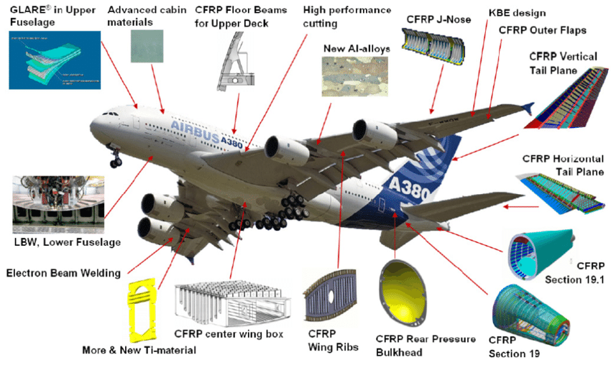
FRP components

Slide 63
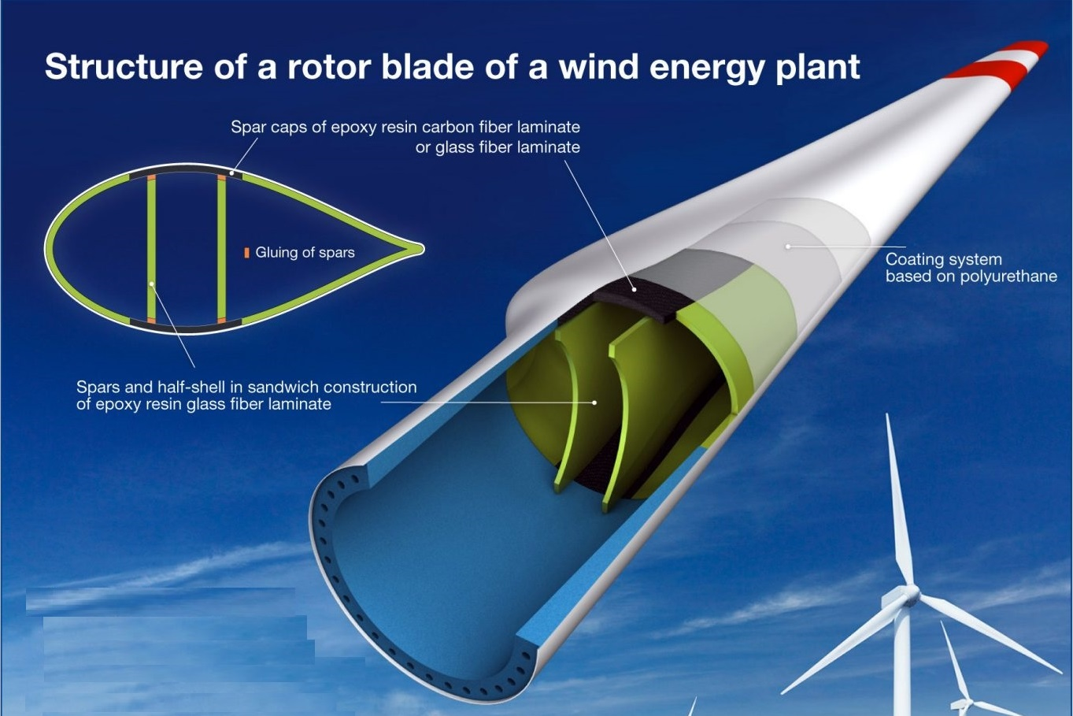
FRP components

Slide 64
Conclusion
Composites is a very wide subject and composite science is still a developing subject.
Lots of standards to be developed jointly with the industries and institutes.
Awareness of composites is very important. Composite training will enhance the skill development.
In India many composites are available in market without test and validation which is very difficult for tractability.

Slide 65
Thank you for your valuable time!

